Slide 1
Repetition and Loop Statements

Slide 2
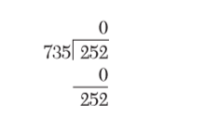
GCD of Two Numbers
The greatest common divisor (GCD) of two integers is the product of the integers’ common factors. Write a program that inputs two numbers and find their GCD by repeated division. For example, consider the numbers 252 and 735. find the remainder of one divided by the other.

Slide 3

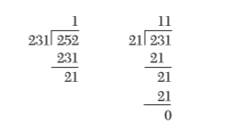
GCD of Two Numbers
Now we calculate the remainder of the old divisor divided by the remainder found
Repeat the process until remainder is zero
The Divisor when remainder is zero is the GCD
21 is the GCD

Slide 4
GCD problem
Input | Output | Logic Involved
Two numbers | GCD of the numbers | Euclidean algorithm, binary GCD algorithm, repeated division method

Slide 5
Algorithm to Find GCD
Step 1: Read the numbers from the user
Step 2: Let dividend = number1 and divisor = number2
Step 3: Repeat step 4 to step 6 while remainder not equal to zero
Step 4: remainder = number1 modulus number2
Step 5: dividend = divisor
Step 6: divisor = remainder
Step 7: GCD = divisor
Step 8: print GCD

Slide 6
Weather Report
Weather station in Chennai has recorded rainfall of first ten days in December 2015 using a rain gauge. Develop an algorithm and write a program to count and print the number of days in which rainfall was low, medium and high. The value given is in cm. If the value is less than 12 then it is low, 12 to 20 is medium and more than 20 is high.

Slide 7
Weather problem
Input | Output | Logic Involved
Rainfall in cm recorded for ten days, ten numbers | Number of days low, medium and high rainfall | Count the number of days with rainfall as low, medium and high

Slide 8
Algorithm for Weather Problem
Step 1: Let counter =0, num_Of_Low = 0, num_Of_Med = 0, num_Of_High = 0
Step 2: If counter == 10 then goto Step 9
Step 3: Read rainfall recorded in cm
Step 4: increment counter
Step 5: if rainfall < 12 then increment num_Of_Low
Step 6: if rainfall is between 12 and 20 then increment num_Of_Med
Step 7:Step 5: if rainfall > 20 then increment num_Of_High
Step 8: Goto Step 2
Step 9: Print num_Of_Low, num_Of_Med, num_Of_High

Slide 9
Implementation
We have to learn how to repeat statements
In some cases the number of times to repeat a statement is known, in weather report example it is ten times we have to repeat some statements
In some other cases the conditions are not direct as a number but as a terminating condition that may be based on I/O. In our GCD problem, the statements are to be repeated till reminder becomes zero

Slide 10
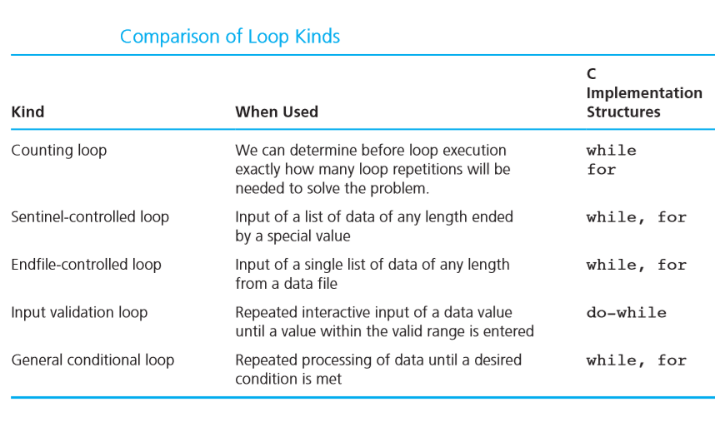

Slide 11
Counter-controlled loop
Used when we can determine prior to loop execution exactly how many loop repetitions will be needed to solve the problem
A counter-controlled loop follows this general format:
Set loop control variable to an initial value of 0 while (loop control variable < final value) . . . Increase loop control variable by 1

Slide 12
Syntax of a For loop
for (loop control variable initialization; loop terminating condition; loop control variable update)
All three components are optional
But semicolons are mandatory

Slide 13
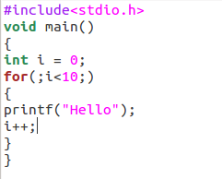

Slide 14
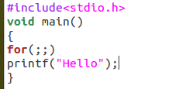

Slide 15
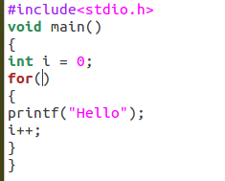

Slide 16
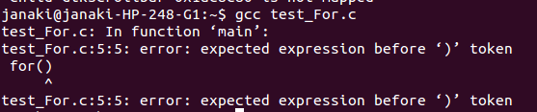

Slide 17
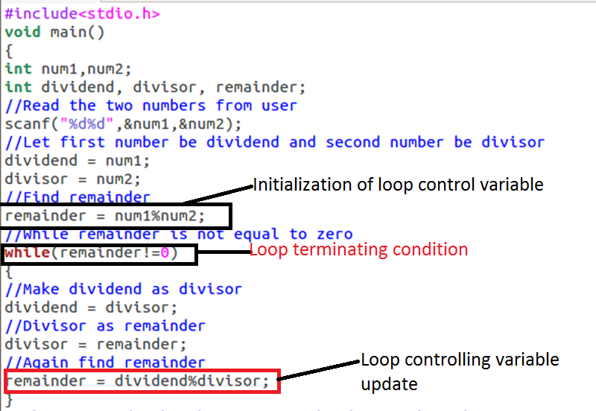
GCD Program Using While

Slide 18
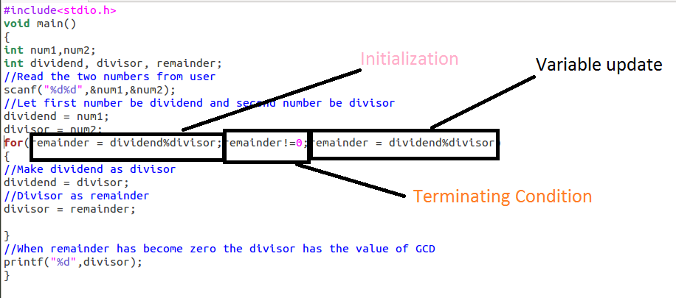
GCD Program Using For

Slide 19
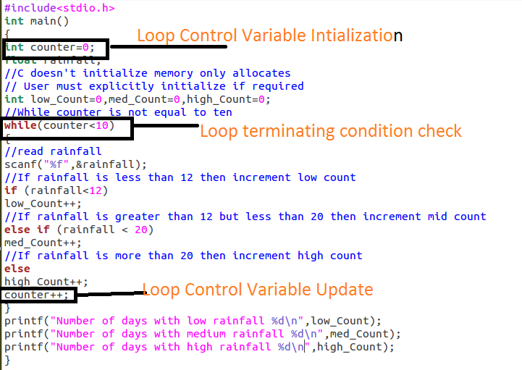
Weather Program Using While

Slide 20
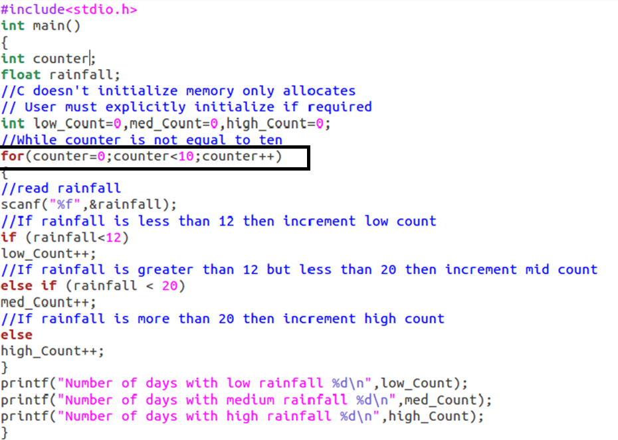
Weather Program Using For

Slide 21
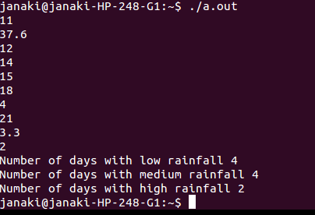

Slide 22
Do while Loop
Similar to a while loop, except the fact that it is guaranteed to execute at least one time
Syntax :
do
{
statement(s);
} while( condition );
Condition is checked at the end of execution

Slide 23
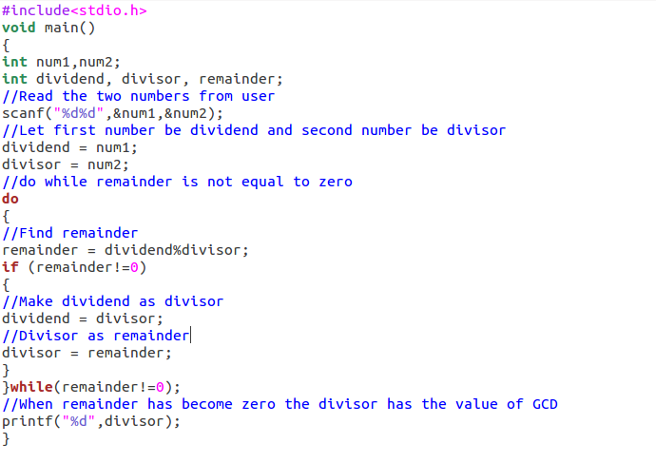
GCD Program Using Do While

Slide 24
Sentinel-Controlled Loops
Consider program that calculates the sum of a collection of exam scores is a candidate for using a sentinel value. If the class is large, the instructor may not know the exact number of students who took the exam being graded. The program should work regardless of class size. The loop below uses sum as an accumulator variable and score as an input variable.

Slide 25
Steps in Sentinel-Controlled Loops
Initialize sum to zero
Get ﬁrst score
while score is not the sentinel
Add score to sum
Get next score

Slide 26
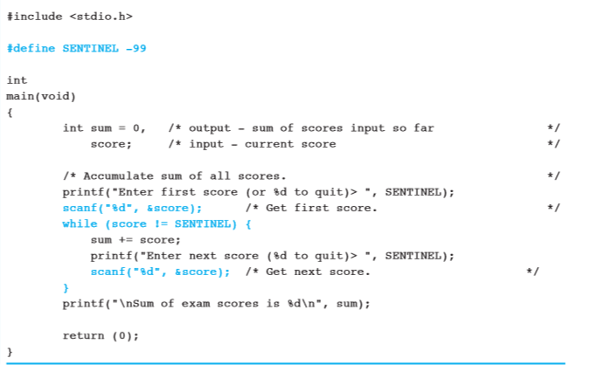

Slide 27
Break and Continue Statements
Interrupt iterative flow of control in loops
Break causes a loop to end
Continue stops the current iteration and begin the next iteration

Slide 28
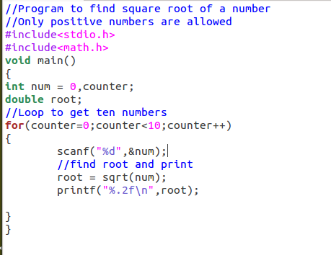

Slide 29
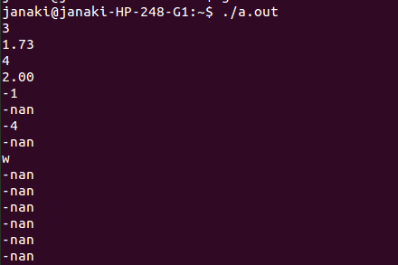

Slide 30
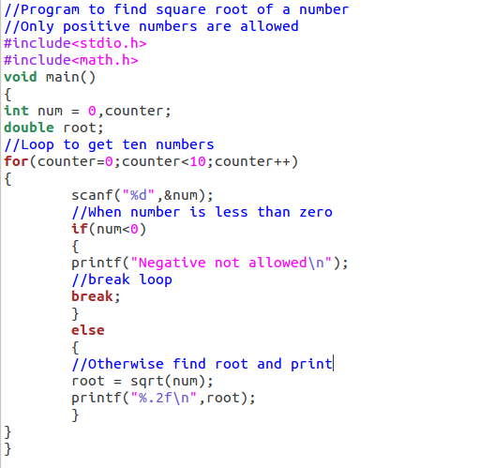

Slide 31
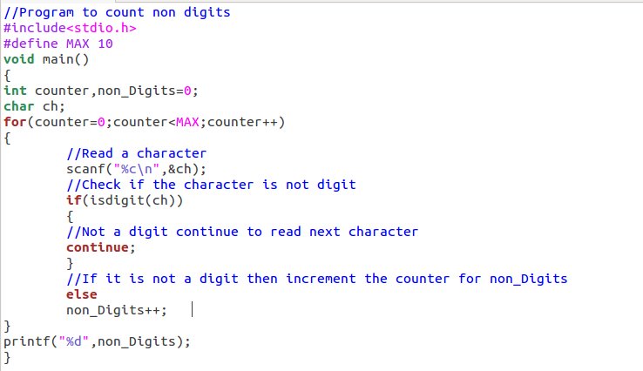

Slide 32
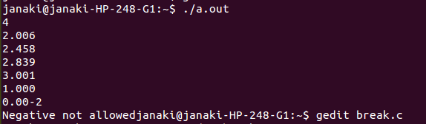

Slide 33
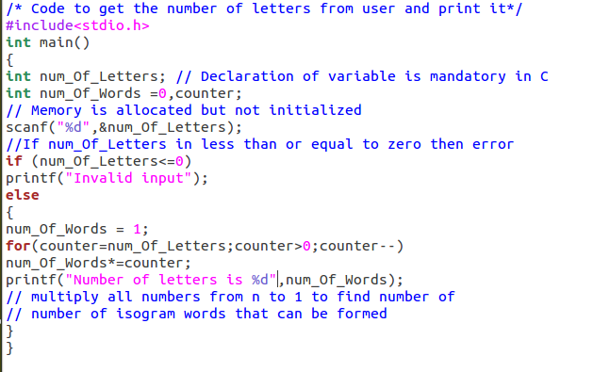
Iterative C code of Isogram Problem

Slide 34
Nested Loops
Loops may be nested just like other control structures.
Nested loops consist of an outer loop with one or more inner loops.
Each time the outer loop is repeated, the inner loops are reentered, their loop control expressions are reevaluated

Slide 35
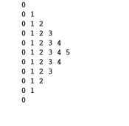
Print Pattern

Slide 36
Analysis
Let ‘n’ is the largest number in the pattern
The pattern consist of 2*n-1 rows
Element in each row increases till ‘n’ is printed and then decreases
Two loops are required
One to print each row
Other one should be used in each row to print elements of the row

Slide 37
Print Pattern
Input | Output | Logic Involved
Value of ‘n’ | Print a pattern | Nested loop single or multiple

Slide 38
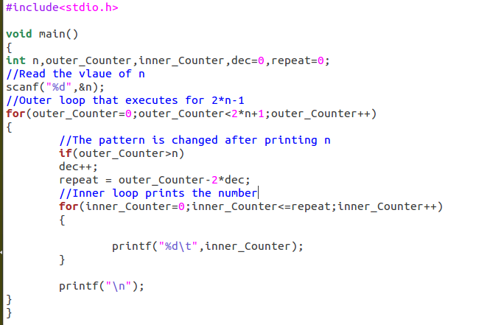

Slide 39
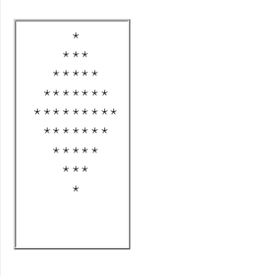
Write a Program to Print the Pattern

Slide 40

Write a Program to Find the Value of Pi upto ‘n’ terms

Slide 41

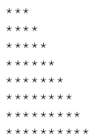
Write a Program to Print the Pattern

Slide 42

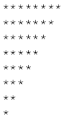
Write a Program to Print the Pattern

Slide 43

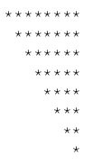
Write a Program to Print the Pattern

Slide 44

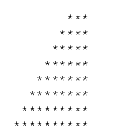
Write a Program to Print the Pattern

